Slide 1
Roughly how our board will look. Middle of the board is of course the biggest piece being 22in across and each wing being 11in across.
Slide 2: Left wing
Slide 3: Middle
Slide 4: Right wing
Not quite the fonts we will use either. Some thing will be draw/written on to the board

Slide 2
Board Layout
**Picture of our board in 0-13 format like in the game**
Machine VS Machine
Heuristic 1: simply compares the number of pebbles in each player’s mancala. If the player’s mancala contains more pebbles than the opponent’s mancala, then that state is preferred. That is, it takes the difference between mancalas.
Heuristic 2:considers pebbles on a player’s side of the board to have already been captured by that player. (Pebbles in opponent’s pit means pebble’s in opponent’s mancala).
Heuristic 3:prioritizes states with more empty pits on a player’s side. The more empty pits, the better.
Heuristic 4: prioritizes states that contain potential capture moves for the player.
Results of Machine vs Machine
**here we will have data about showing the different heuristics and how they did when pitted against each other. Also this will take in to account AB(0-8)**

Slide 3
MANCALA
Luke Johnson and Chandler Capps
How to play
Goal of the Project
Each player has a Mancala that will hold all of their pieces that they score
You will pick from one of your six pits (depends on which side you sit on) and you will place one piece in every pit you go across until you have run out of pieces from the pit you picked up
Every time you pass through your Mancala, you will drop off a piece as a point
If you land in one of your spaces with zero pieces in it then you get the opponent's pieces on the opposite side as well immediately in your Mancala
If a player runs out of pieces on his side then the opponent gets the rest of the pieces that remain on his side
The score is decided after all pieces have been accounted for
The goal of our project was to construct a program that could intellectually play the game of Mancala in a manner that was close to human choice.
Next was to make this program smart enough to predict further into the game than an average Mancala player can often perceive and make choices that would give the program the upper hand in the game.
Here is our attempt at just that without using what we call Neural Networks (just like the human mind), rather we used Alpha-Beta search trees to be able to look far enough ahead to get possible outcomes and make the most efficient choice

Slide 4
Heuristics and Alpha-Beta
What is Alpha-Beta?
Fourth Heuristic Code
a = board.get(self.h - 1) - board.get(int(self.h/2 - 1))b = 0 c = 0 for x in range(0, int(self.h/2 - 1)): y = board.get(x) % self.h d = (self.h - 2) - ((x) % self.h) if y < int(self.h / 2) and board.get(y) == 0 and board.get(d) != 0: b += board[d] for x in range(int(self.h/2), int(self.h - 1)): y = board.get(x) % self.h d = (self.h - 2) - ((x) % self.h) if y > int(self.h / 2) and board.get(y) == 0 and board.get(d) != 0: c += board[d] if player == 'Player': util = -a + (b - c) else: util = a + (c - b) return util
Alpha-Beta is essentially and adversarial search tree which uses min and max values to help it decide what is the best decision for the program to make and lead it to victory
We use the word ply a good bit; when we talk about ply that means how deep the search tree goes (or how far it will search ahead). Look below for an idea of what this would look like.
What is a heuristic?
A way to compare states giving them numerical value in which Alpha-Beta will prioritizes those states in whatever manner you want it to. These help Alpha-Beta figure out the best move to take by giving it the most probable position of pieces and doing the algorithm with those values it gives.

Slide 5
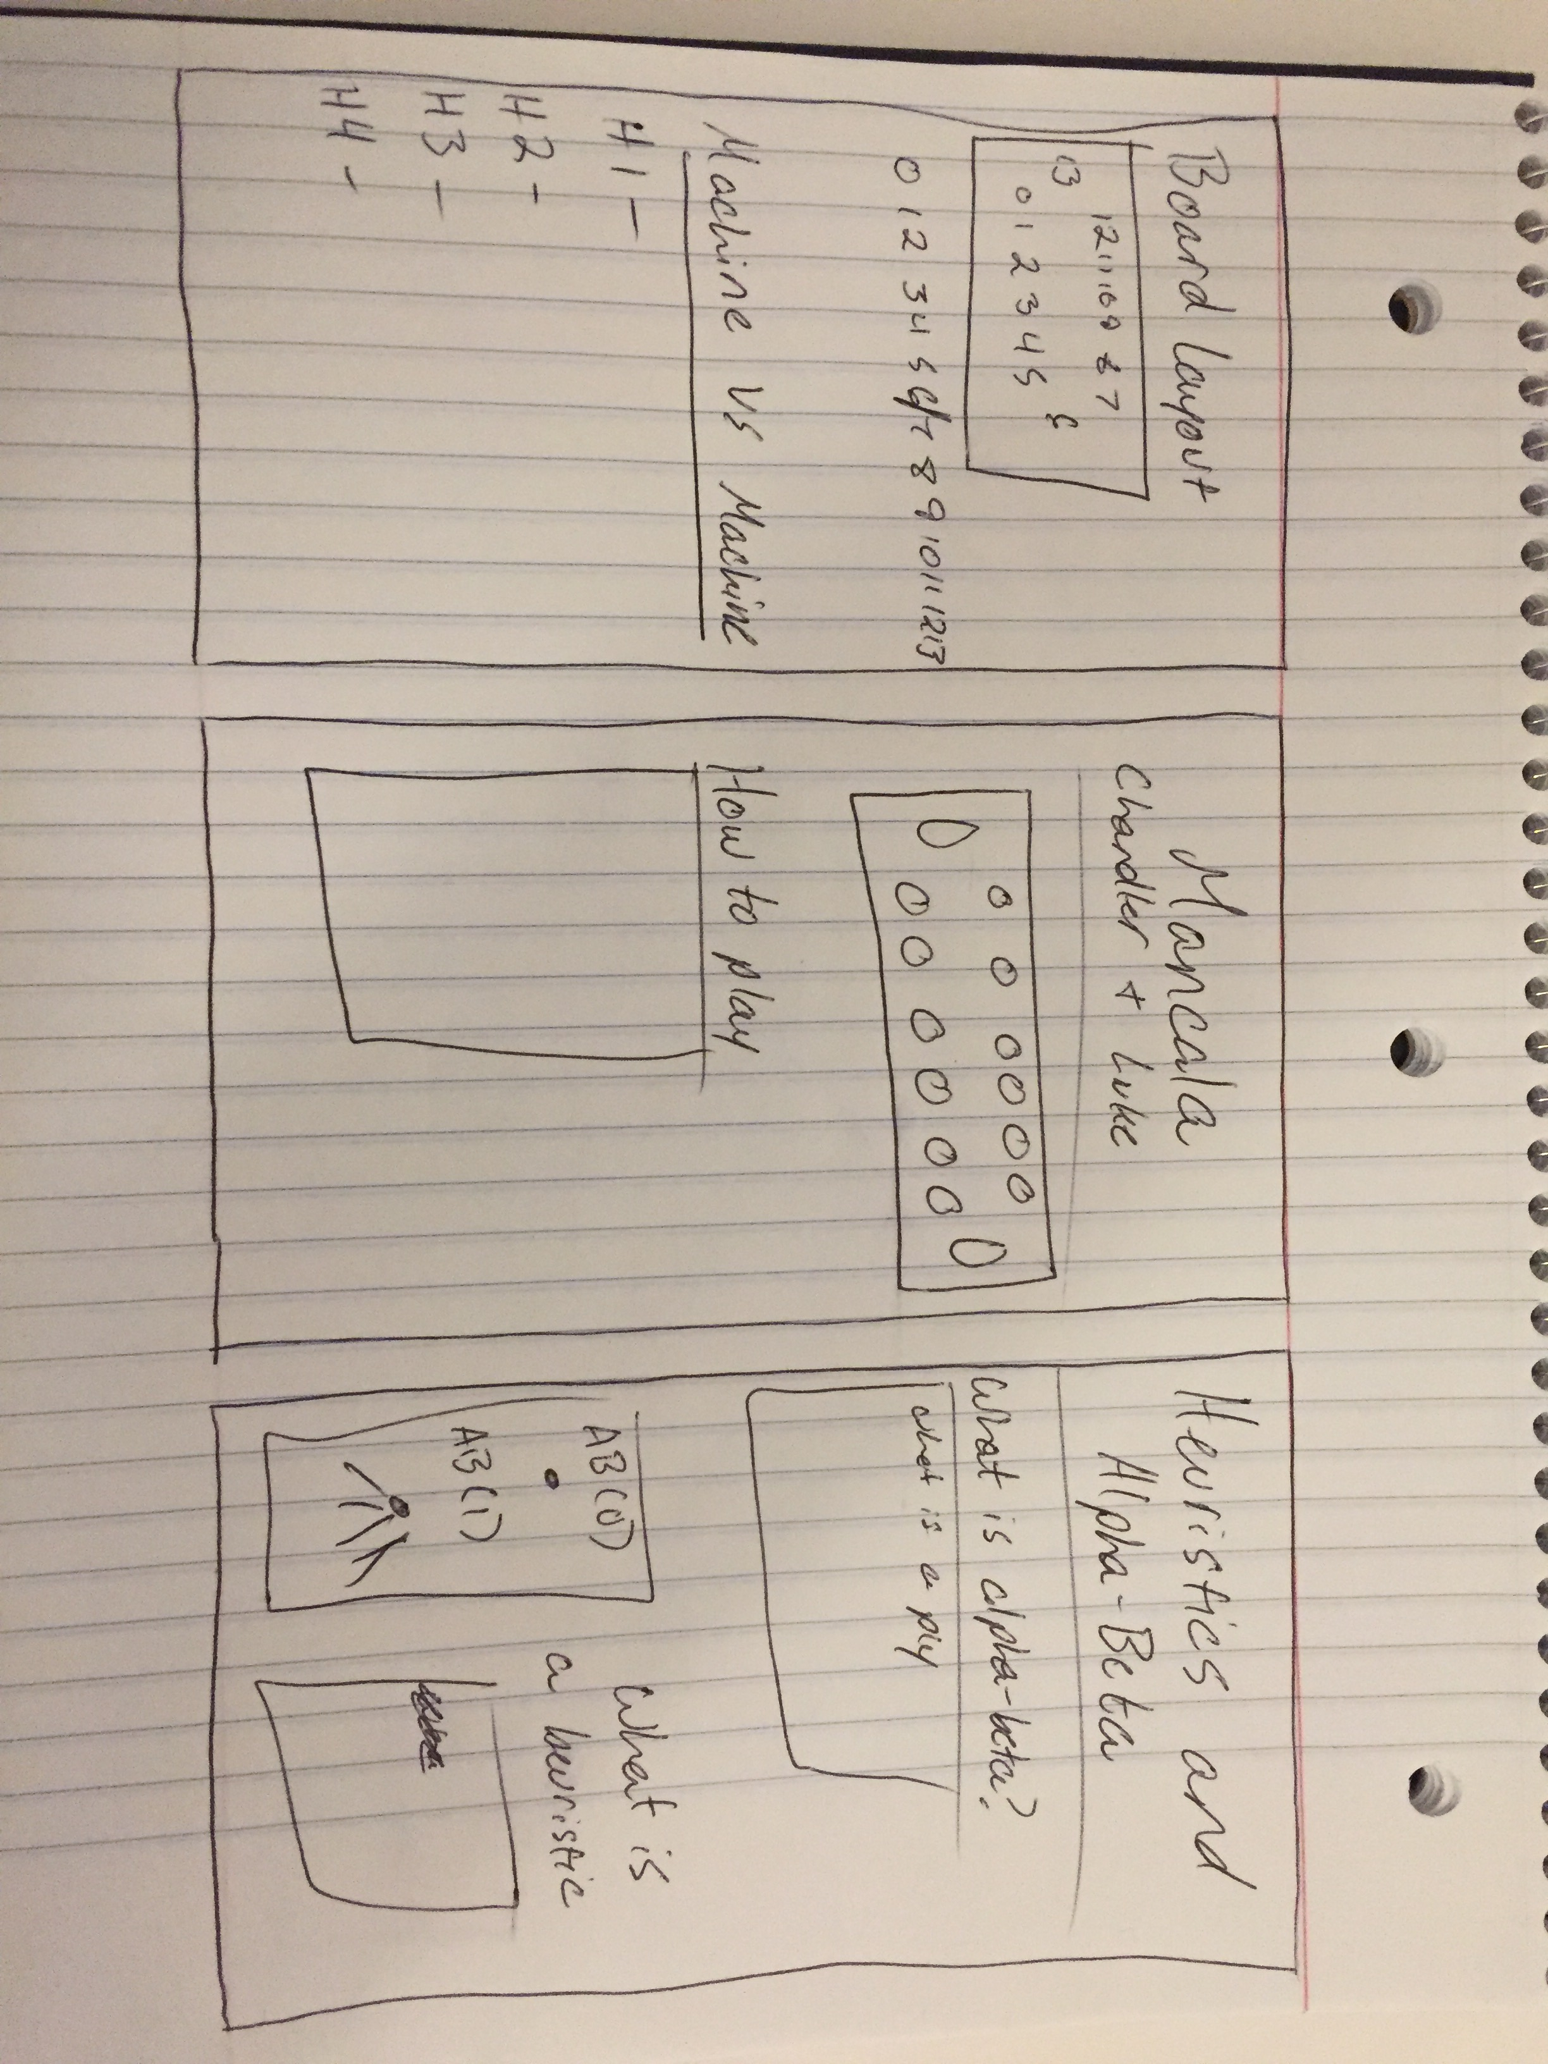
Rough drawing of what we used to make this powerpoint. with modifications

